Slide 1

Heart Smart Presentation

Slide 2

Overview
What we will cover:
- Recapping the objectives
- Addressing the direction of the project
- Discussing Stakeholders
- Requirements
- System Architecture
- User Interface
- Timeframe/Schedule

Slide 3
Recapping The Objectives
Create a Machine Learning Model that Predicts Risk of Developing Coronary Artery/Heart Disease
Create fully function application that deploys this model and takes in user information
Allows user to log medicine and exercise data
Provides facts and fun quizzes to educate user

Slide 4
Direction of Project
Changes made in the stack
Why changes were made
What is staying the same
What might end up being tweaked or changed

Slide 5
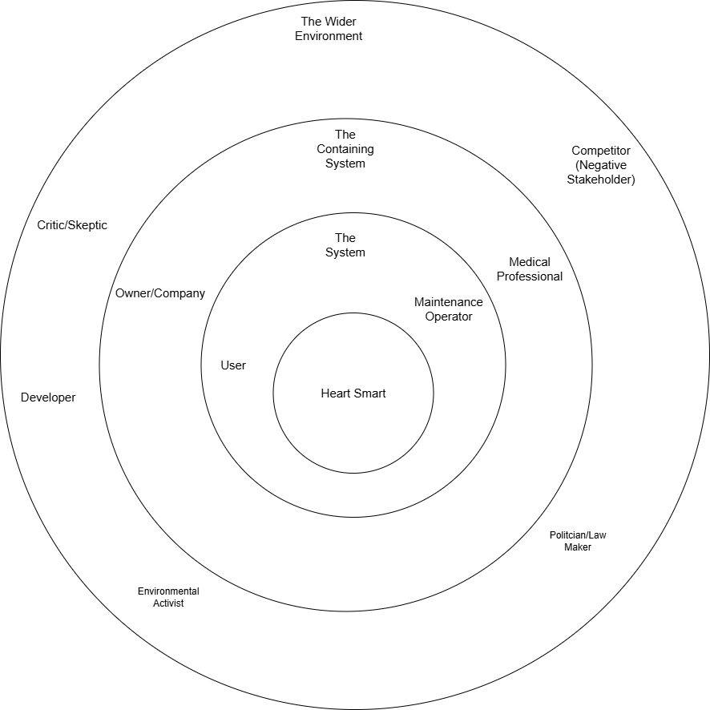
Stakeholders
- There are many stakeholders
- Briefly explain them
- Stakeholders we chose to involve
- Medicine students/professionals due to time and ability/ethics
- Medical students know what’s needed
- Their inputs

Slide 6
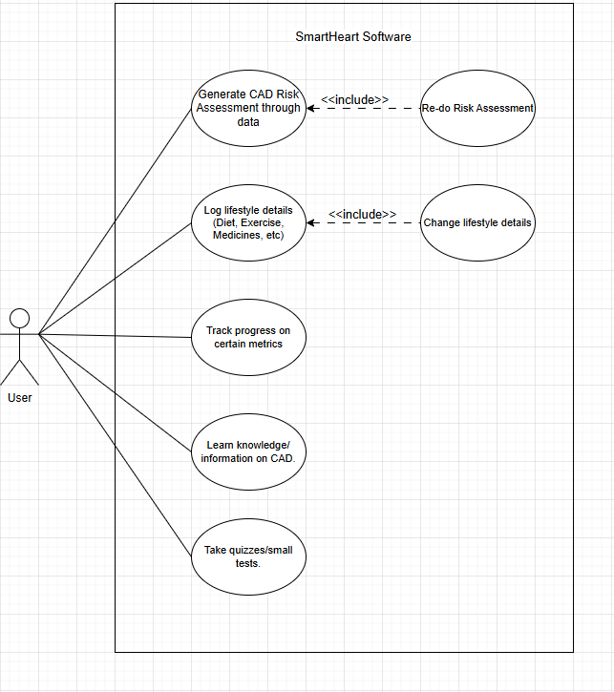
Requirements
Functional Requirements:
Authentication and user management:
-The system shall allow a user to register with an email and password.
-The system shall allow a user to log in with email and password.
-The system shall issue a JWT upon successful login/registration.
-The system shall restrict protected resources to authenticated users only.
-The system shall support logout by clearing the stored token on the client.
-Risk assessment (prediction)
-The system shall allow an authenticated user to submit risk input data (e.g., age, sex, BMI, smoking, diabetes, BP, cholesterol, glucose).
-The system shall support unknown inputs for selected fields and send these as flags (e.g., unknown_flags) to the ML service.
-The system shall send validated/filtered model inputs to the ML microservice for inference.
-The system shall return a prediction result including:
numeric risk score
risk band/category
confidence level
optional range/interval if provided
model/rules version metadata (if returned)
-The system shall display prediction results to the user in the UI.
-Logbook (medicines + exercises)
-The system shall provide an authenticated user with a logbook page.
-The system shall allow the user to create, edit, and remove medicine entries in the logbook.
-The system shall allow the user to create, edit, and remove exercise entries in the logbook.
-The system shall allow the user to save logbook entries to persistent storage (MongoDB).
-The system shall allow the user to reload logbook entries from persistent storage.
Snapshotting and history:
-The system shall store a RiskAssessment record each time an authenticated user requests a prediction.
-The system shall store the raw input request submitted by the user (rawRequest).
-The system shall store the exact ML payload sent to the ML service (rawMlRequest).
-The system shall store the full ML response returned (rawMlResponse).
-The system shall store a snapshot of the user’s current logbook (medicines and exercises) within the RiskAssessment record at prediction time.
-The system shall provide a history page listing prior risk assessments for the authenticated user.
-The system shall ensure history is user-specific (users can only view their own records).
-API and service interactions
-The system shall expose REST API endpoints for:
-auth (register/login)
-logbook (get/update)
-risk assessment (predict + persist)
-history retrieval
-health check
-The system shall call the ML service using a configurable URL (ML_SERVICE_URL).
-The ML service shall expose an endpoint to perform inference (e.g., POST /predict).
Deployment
-The system shall be deployable such that an examiner can access it via a single public frontend URL.
-The system shall support configuration via environment variables for deployed environments (e.g., Mongo URI, JWT secret, ML URL, API base).
Non-functional requirements:
Usability and UX:
-The UI shall be simple and minimal, enabling an examiner to use the full workflow without training.
-The UI shall provide clear feedback for loading/saving actions (e.g., “Saving…”, “Please wait…”).
-The UI shall display meaningful error messages when operations fail (login, prediction, save/load).
-Performance:
-The API shall respond to typical requests within a reasonable time under normal load (target: a few seconds).
-The prediction call shall use a timeout to prevent indefinite hangs when the ML service is slow/unavailable.
-The database queries shall be efficient for expected usage (single-user scale; history limited/paginated).
-Reliability and availability
-The system shall tolerate transient downtime/cold starts of hosted services (Render free tier).
-The system shall fail gracefully if the ML service is unavailable, returning a clear error.
-The system shall persist user data (logbook/history) reliably in MongoDB Atlas.
Security and privacy:
-The system shall store passwords as secure hashes (not plaintext).
-The system shall require JWT authentication for protected endpoints.
-The system shall prevent users from accessing other users’ data (server-side authorization checks).
-The system shall keep secrets out of source control (e.g., .env not committed).
-The system shall use HTTPS in deployment (Render-managed TLS).
Maintainability:
-The codebase shall follow a modular structure (separated routes/models/utils; separated React pages/components).
-The system shall support configuration changes without code changes (env vars).
-The system shall be understandable and extensible (e.g., adding new tracked lifestyle items later).
Portability and deployment:
-The system shall run locally for development and in a hosted environment with minimal changes.
-The system shall be deployable from a Git repository with automated builds.
-The system shall document how to run and deploy (README / examiner instructions).
Data integrity:
-The system shall keep historical risk assessments immutable (snapshot pattern).
-The system shall use consistent schema fields for stored documents (User, Logbook, RiskAssessment).
-The system shall ensure logbook is 1:1 per user (unique userId).

Slide 7
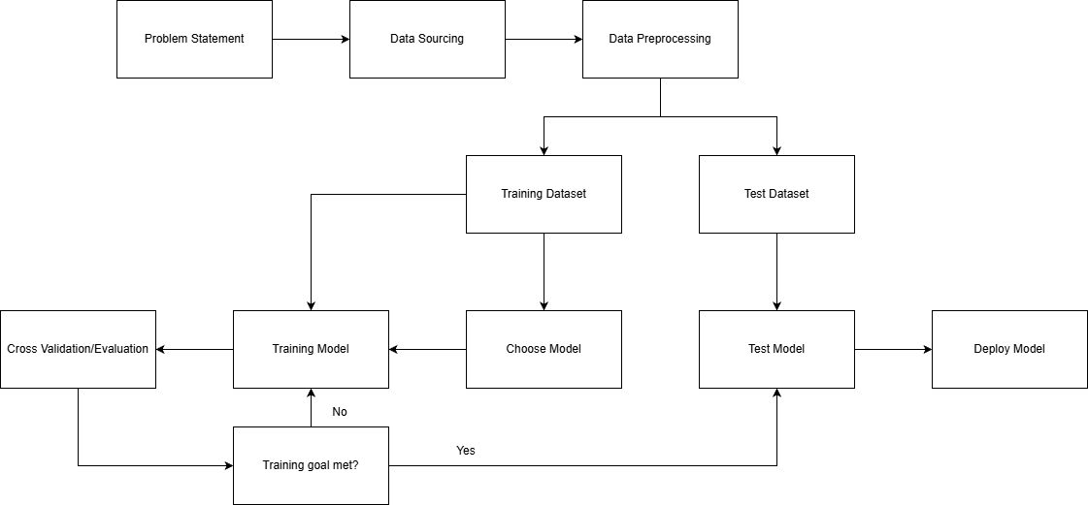
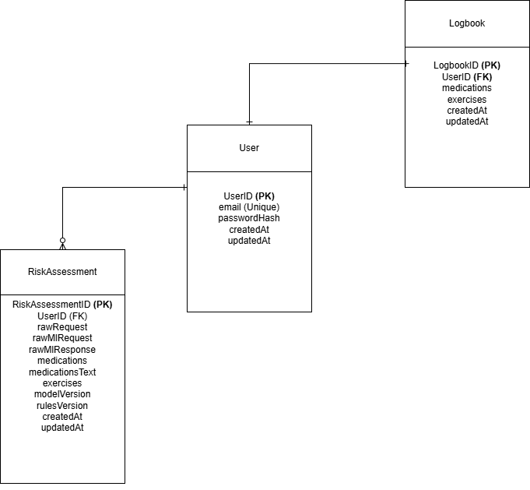
System Architecture
-MERN Stack
-Choosing to change from Streamlit
- Functionally still the same just different tools

Slide 8
User Interface & Work to do
A lot of work to be done on UI
Quiz and facts section WIP

Slide 9
Timeframe/Schedule
Slightly behind but not by much
Reasoning behind delays

